Slide 1
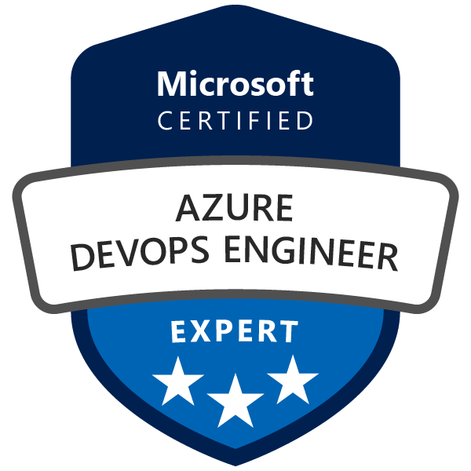
Exam AZ-400: Microsoft DevOps Solutions Crash Course
Tim Warner @TechTrainerTim

Slide 2


Tim Warner
Based in Nashville, TN, US
MCT, MVP
Twitter: @TechTrainerTim
Badge: TechTrainerTim.com

Slide 3
Session 1 of 2 Learning Goals
Develop a SRE strategy (5-10%)
Develop a security & compliance plan (10-15%)
Manage source control (10-15%)
Develop an instrumentation strategy (5-10%)

Slide 4
Session 2 of 2 Learning Goals
Define and implement CI pipelines (20-25%)
Define and implement a CD/RM strategy (10-15%)
Facilitate communication & collaboration (10-15%)
AZ-400 exam tips & tricks throughout!

Slide 5
Course Materials
timw.info/az400

Slide 6
Setting Expectations
This is a six-hour "crash course"
Please plan to review these materials more than once
10-minute break at midpoint
Please ask/answer questions and provide feedback in the Q/A panel, not the group chat
I'll post outstanding questions/answers to my Twitter feed: @TechTrainerTim

Slide 7

A Surgical Approach
We cut closely to the exam objectives and precisely what information you need to know to clear the AZ-400 exam (respecting NDA, of course)
The AZ-400 exam is a mile wide and a foot deep

Slide 8

Session Recordings

Slide 9
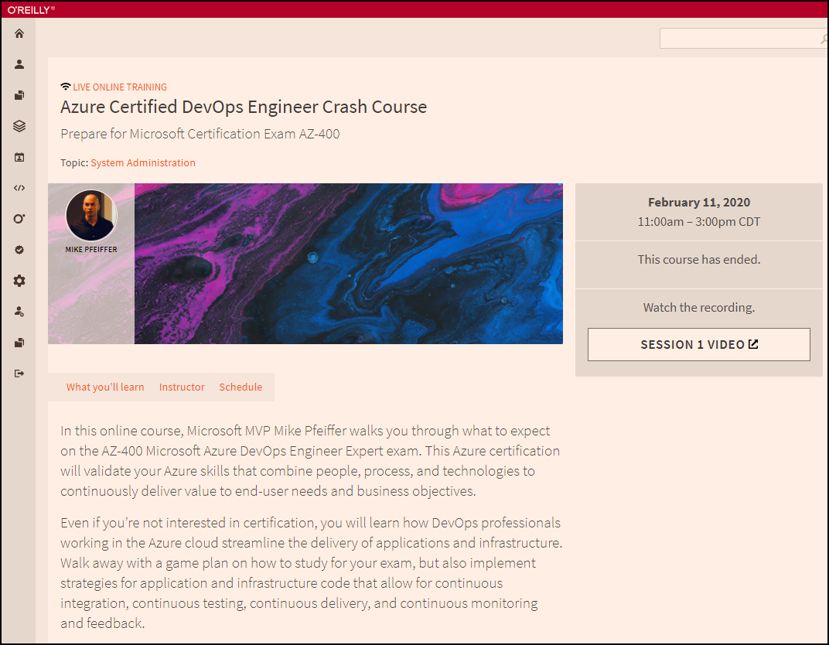
Session Recordings

Slide 10

Session Recordings

Slide 11
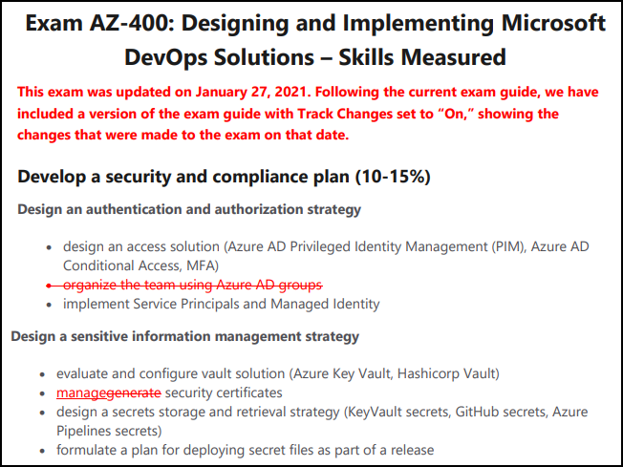
Exam AZ-400 Latest Updates

Slide 12
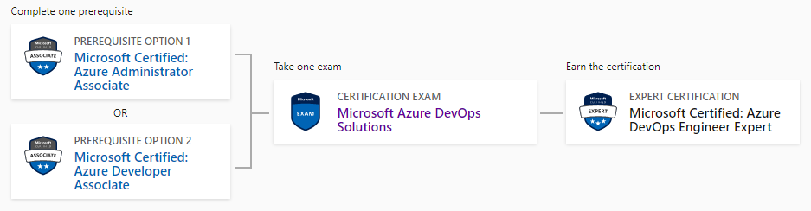
DevOps Engineer Expert Certification
AZ-104
AZ-400
AZ-204

Slide 13
Tim's Suggested Certification Strategy
Clear Exam AZ-104, Microsoft Azure Administrator, first
You need those core infrastructure skills
JSON, PowerShell
Monitoring
Then clear Exam AZ-400
AZ-400 is about development principles, not programming
This course gives you the dev foundations
You need to already have the ops foundations

Slide 14
Tim's Certification Study Pyramid
Interdependence
Content knowledge
Practical application
Test-taking skills

Slide 15
Thank you!
Course materials: timw.info/az400
Twitter: @TechTrainerTim
Work: timw.info/ps
Web: TechTrainerTim.com

Slide 16
Develop an SRE Strategy

Slide 17
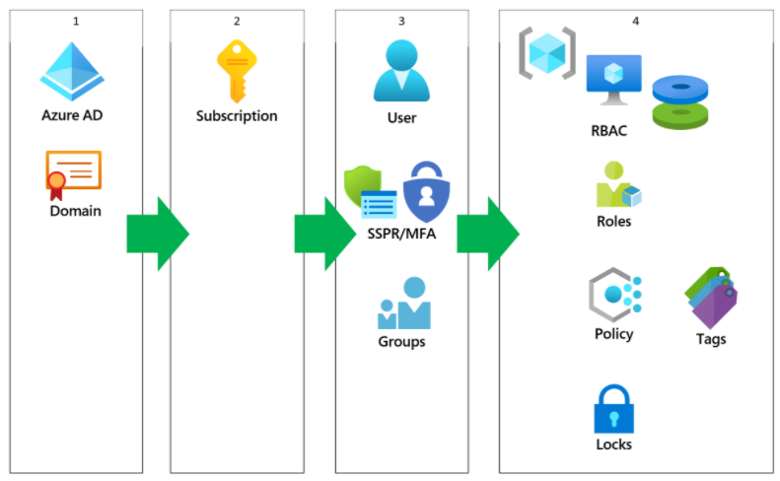
Azure AD Identity

Slide 18
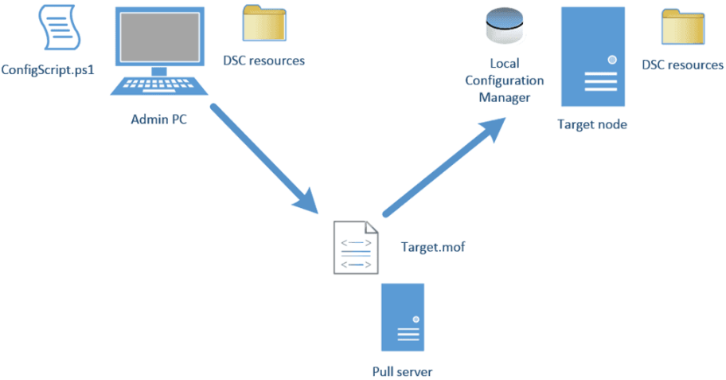
Azure Automation DSC

Slide 19
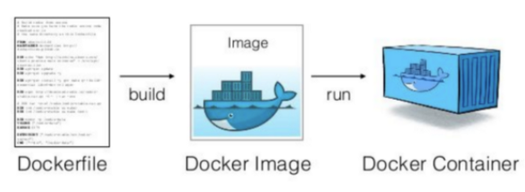
Docker Container Development Process

Slide 20
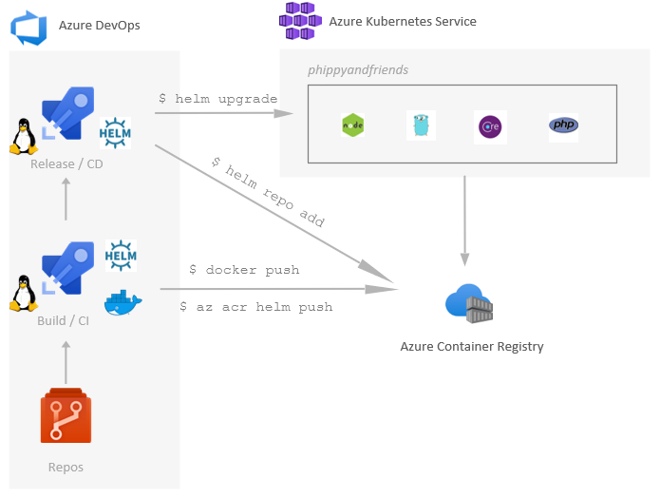
Helm, ACR, and AKS

Slide 21
Develop a Security and Compliance Plan

Slide 22
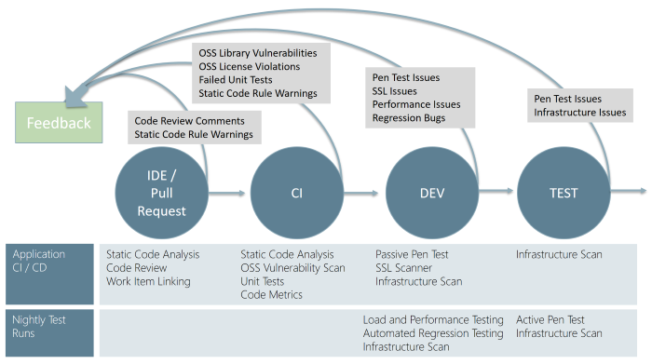
Continuous Security Validation

Slide 23
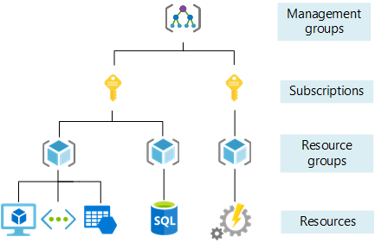
Azure Management Scopes

Slide 24
Manage Source Control

Slide 25
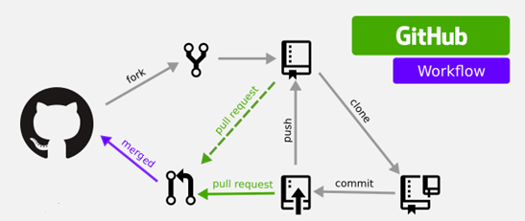
GitHub Workflow

Slide 26
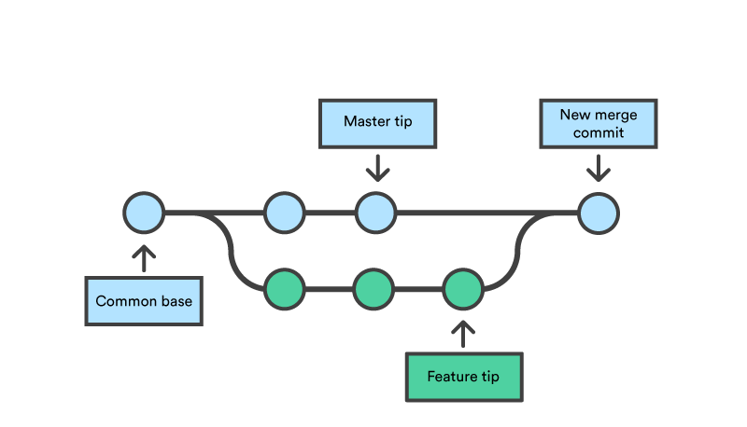
Feature Branching and Merging

Slide 27
Source Control and SRE Strategy

Slide 28

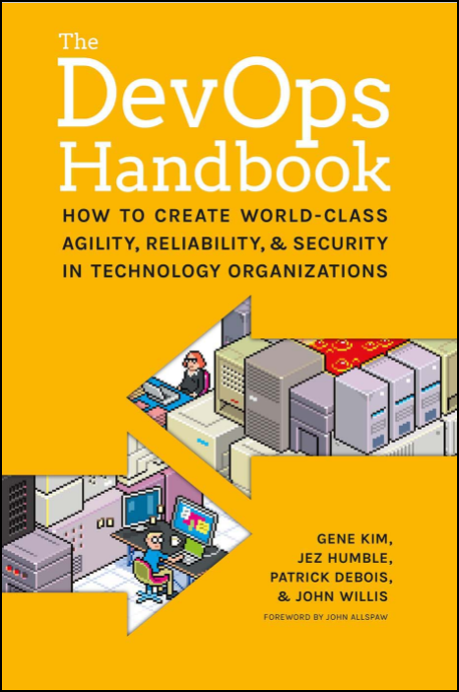


DevOps Reading List

Slide 29
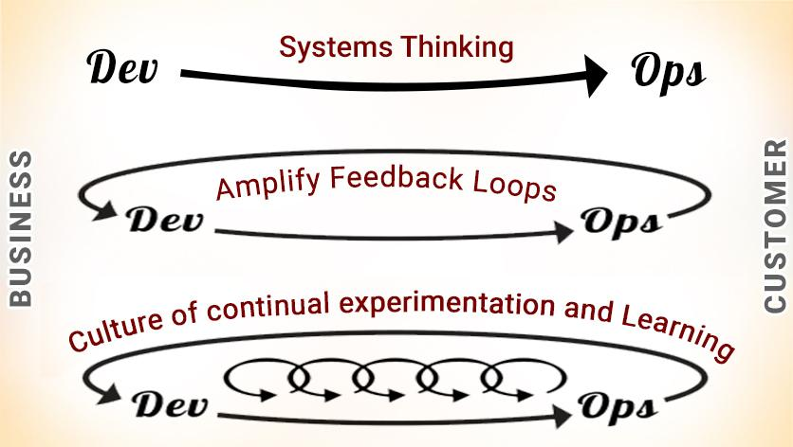
DevOps - The Three Ways

Slide 30
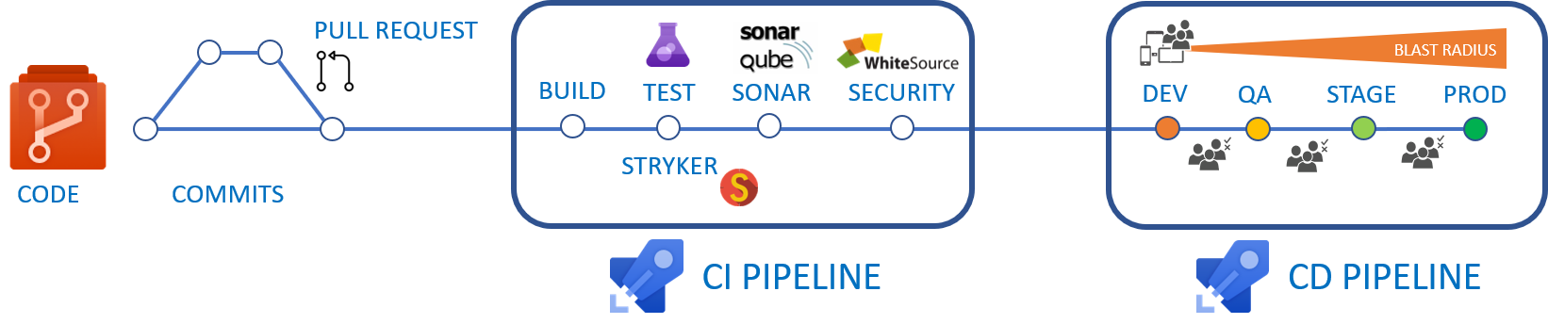
CI/CD Pipelines

Slide 31
Formats 'n' Languages
Data formats
JSON
YAML
Languages
Azure PowerShell
Azure CLI
Dockerfile
KQL

Slide 32
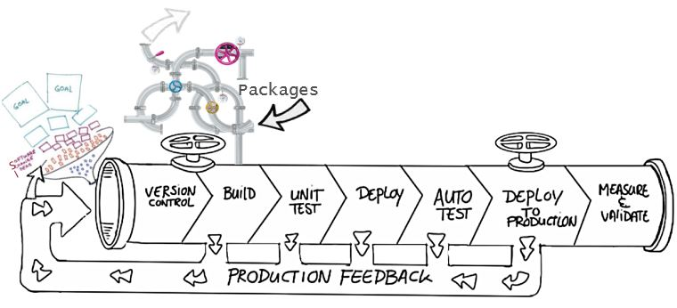
Benefits of source control
Create workflows
Work with versions
Collaboration
Maintains history of changes
Automate tasks
Notes:
Benefits include: Reusability, traceability, manageability, efficiency, collaboration, and learning

Slide 33
Centralized source control
Strengths | Best Used for
Easily scales for very large codebases Granular permission control Permits monitoring of usage Allows exclusive file locking | Large integrated codebases Audit and access control down to the file level Hard to merge file types
Centralized
There is a single central copy of your project, and programmers commit their changes to this central copy.
Common centralized source control systems are TFVC, CVS, Subversion (or SVN), and Perforce.

Slide 34
Distributed source control
Strengths | Best Used for
Cross platform support An open-source friendly code review model via pull requests Complete offline support Portable history An enthusiastic growing user based | Smaller size (in bytes) and modular codebases Evolving through open-source Highly distributed teams Teams working across platforms Greenfield codebases
Distributed
Every developer clones a copy of a repository and has the full history of the project.
Common distributed source control systems are Mercurial, Git, and Bazaar.
Notes:
A greenfield project is one that lacks constraints imposed by prior work.

Slide 35
Continuous Security Validation

Slide 36
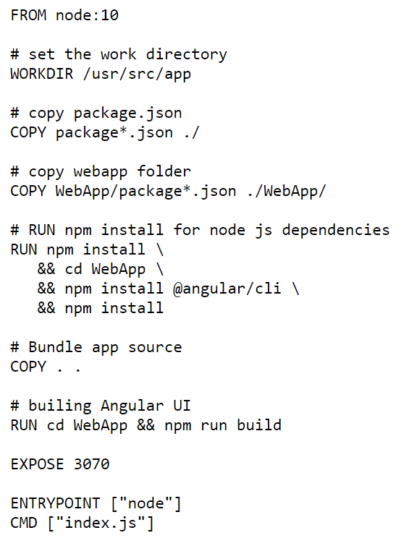
Single-Stage Dockerfile

Slide 37
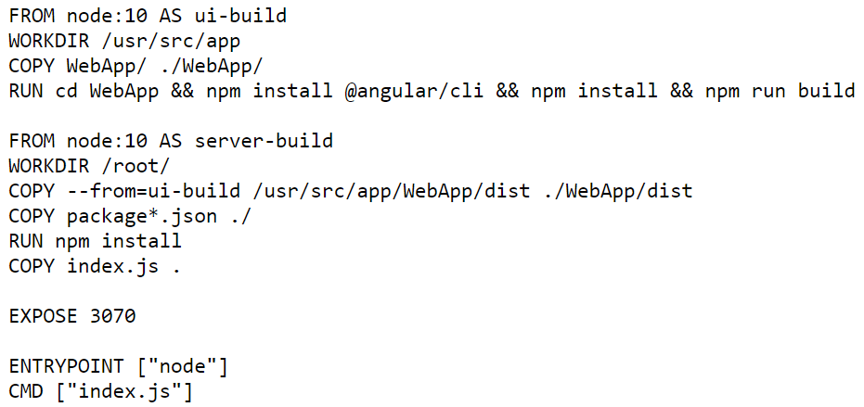
Multi-Stage Dockerfile

Slide 38
Helm, ACR, and AKS

Slide 39
Title

Slide 40
Title

Slide 41
Title

Slide 42
Title

Slide 43
Exam AZ-400 Exam Strategy

Slide 44
Preparing for Online Testing

Slide 45
Tim's Online Testing Video
timw.info/online

Slide 46

Why Microsoft Online Testing?
COVID means Pearson VUE physical testing centers are unavailable
The Pearson OnVUE client has come a LONG way
I'll use online testing exclusively from now on

Slide 47

Pearson OnVUE System Requirements
Windows 10 / Windows 8.1
macOS High Sierra (10.13)
4 GB RAM
1024x768/16 resolution
1920x1080/32 recommended
Touchscreens are prohibited

Slide 48

Pearson OnVUE System Requirements
3 Mbps down/up network bandwidth
Mobile hotspot tethering is prohibited
Browsers:
IE 11, Edge, Chrome, Firefox, or Safari (latest versions)

Slide 49

Pearson OnVUE System Requirements
Webcam: 640x480/10 fps
Microphone: integrated
Headsets not allowed
Corporate VPNs, firewalls, and proxies will likely disrupt the delivery
Check with networking team first

Slide 50
Your Pre-Exam Checklist
Computer set up
Kill all tasks except for your browser
May need to use Task Manager or Activity Monitor
Additional monitors turned off
Mobile phone
ID

Slide 51
During the Exam
Keep your face in the webcam frame
Keep your hands away from your mouth
Ensure you aren't interrupted
Walled room
Door closed
No bio breaks are allowed

Slide 52
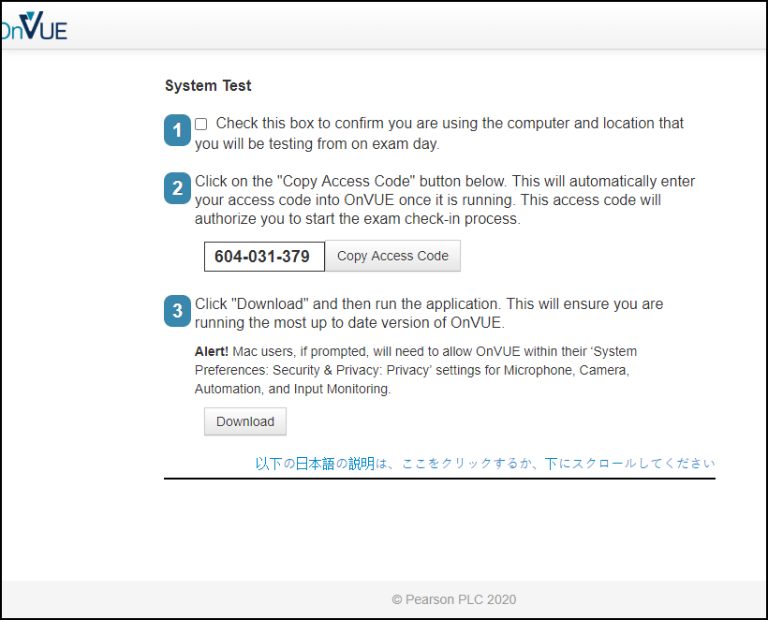

Slide 53
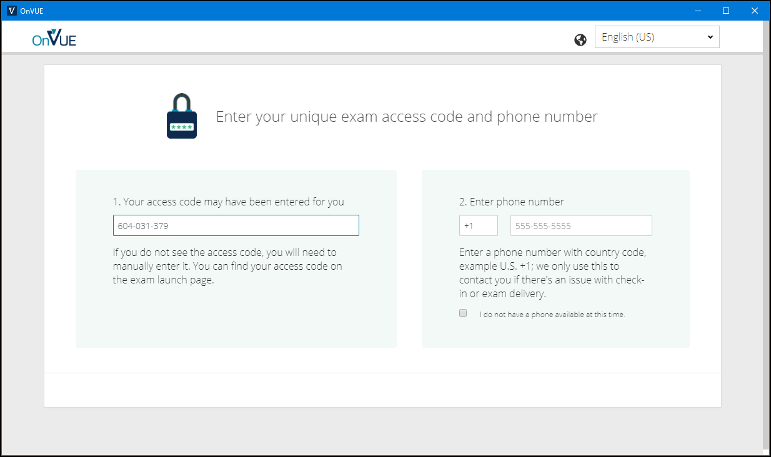

Slide 54
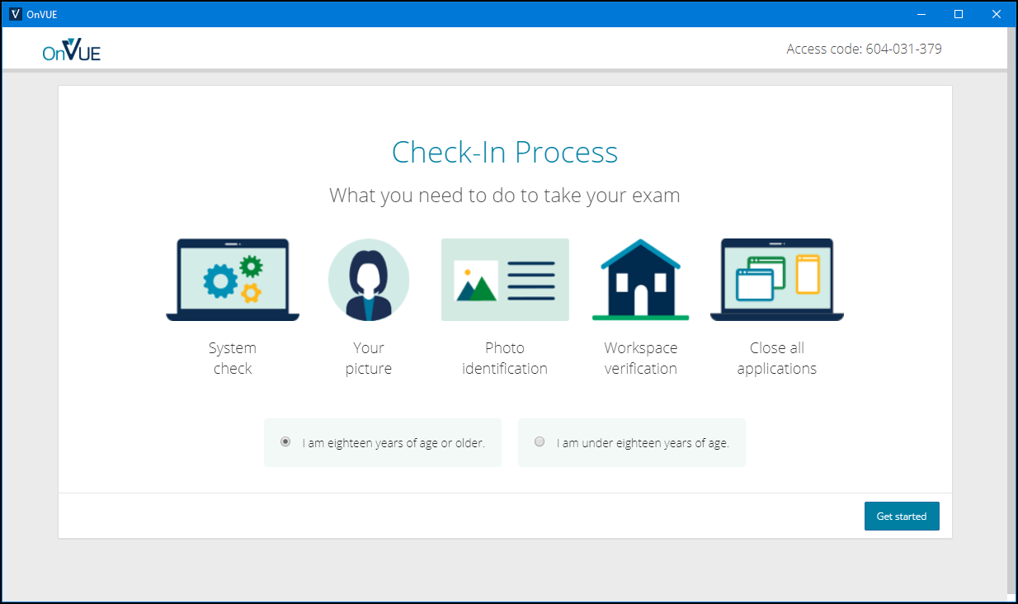

Slide 55
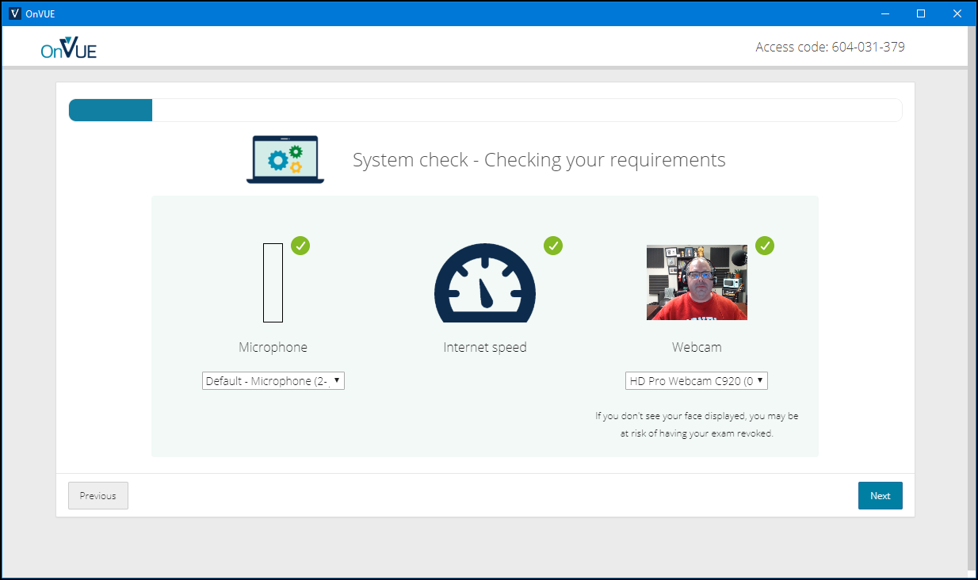

Slide 56
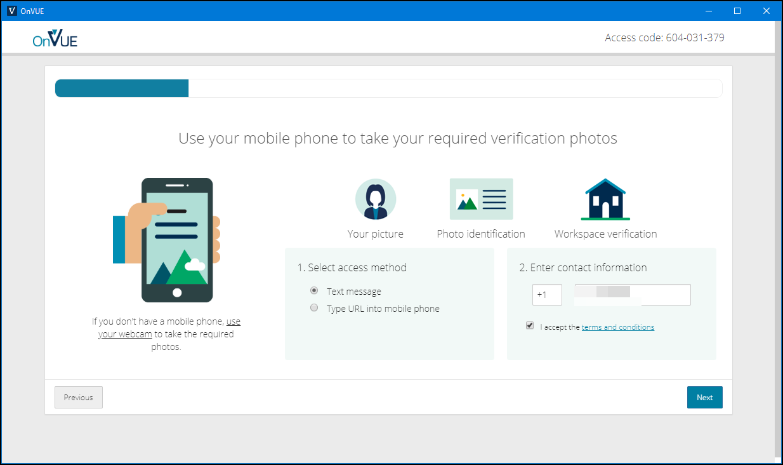

Slide 57
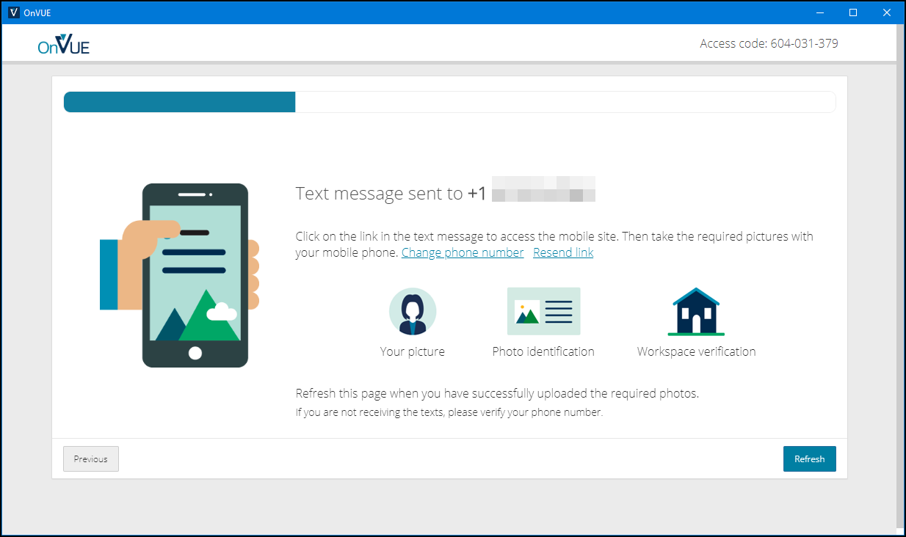

Slide 58
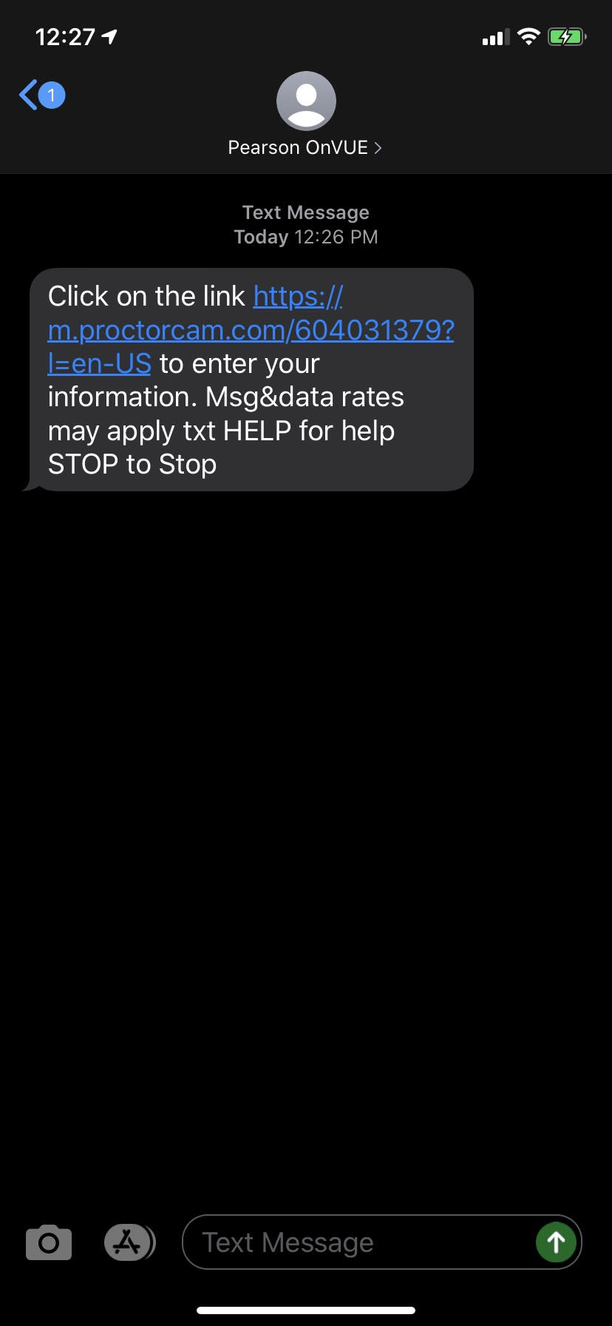
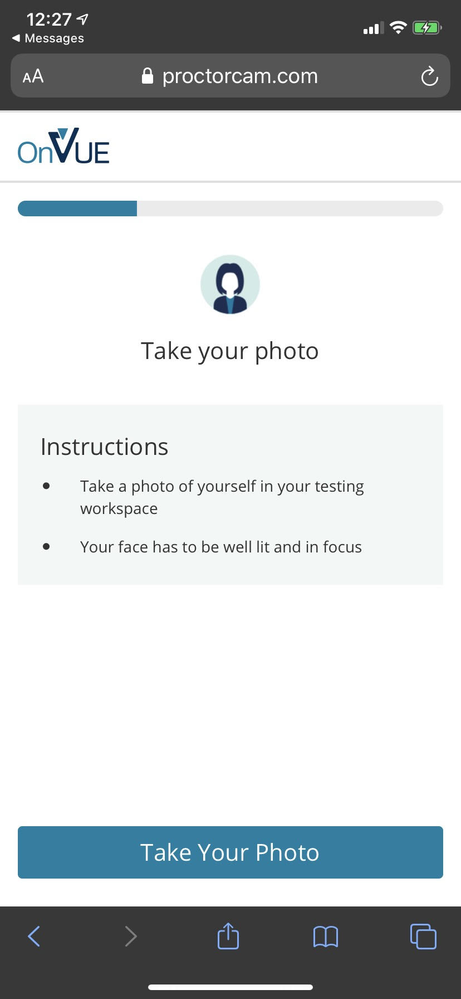
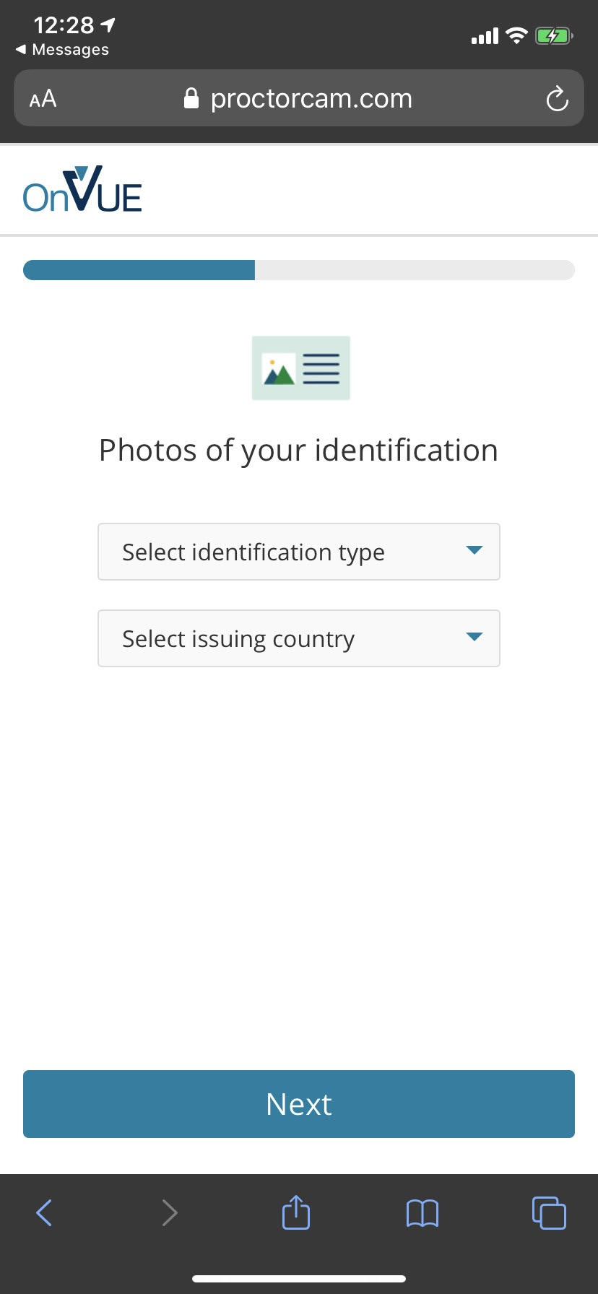

Slide 59
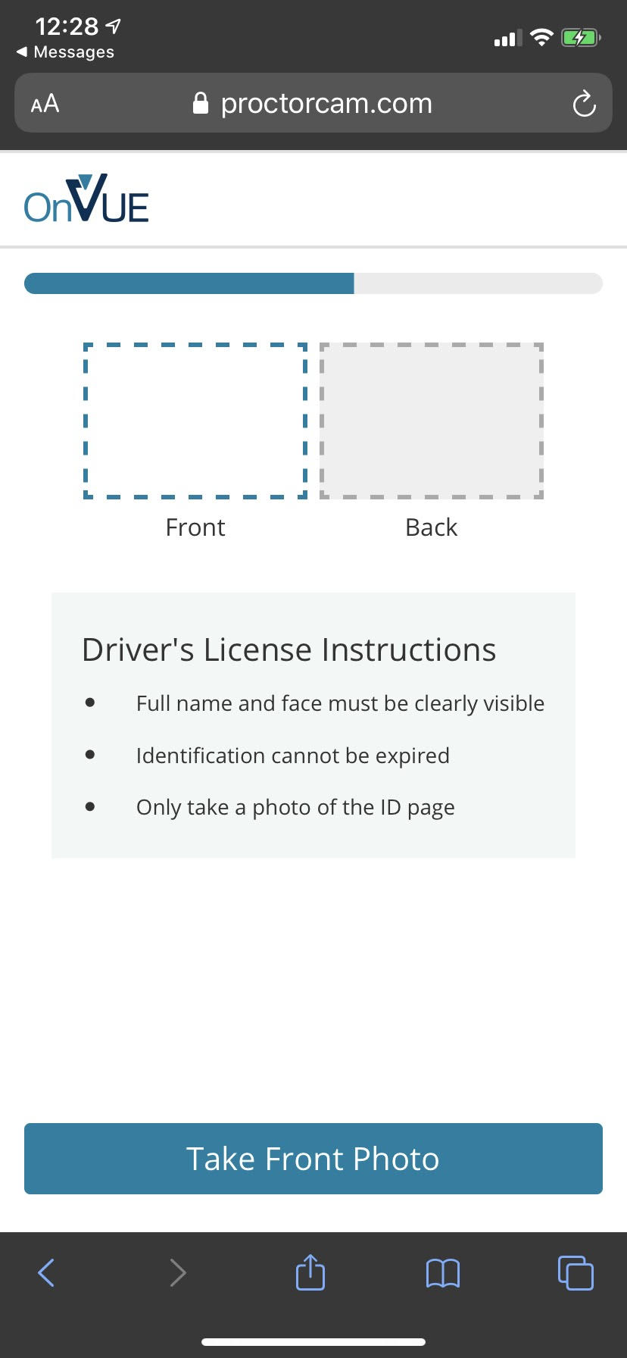
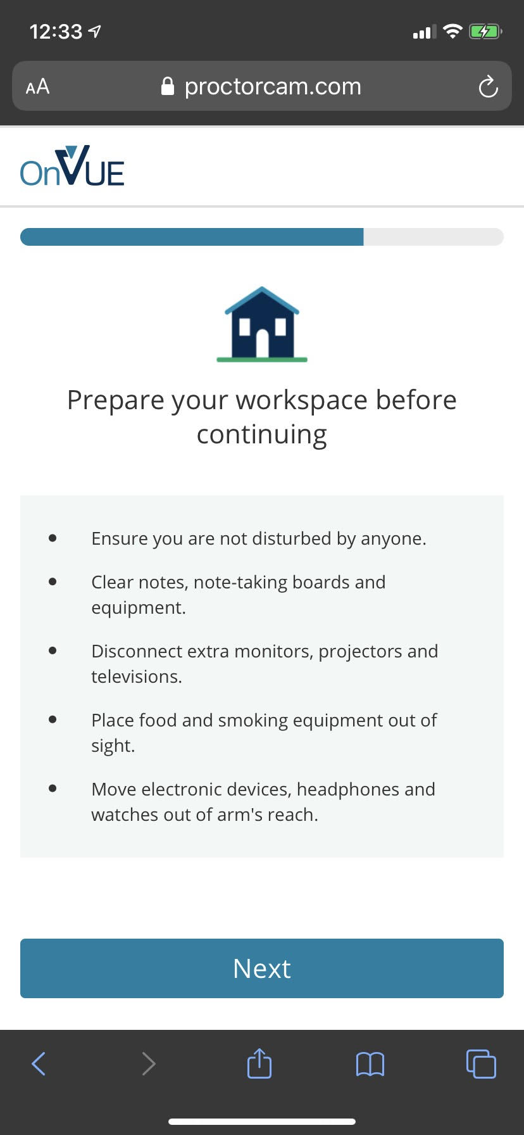

Slide 60
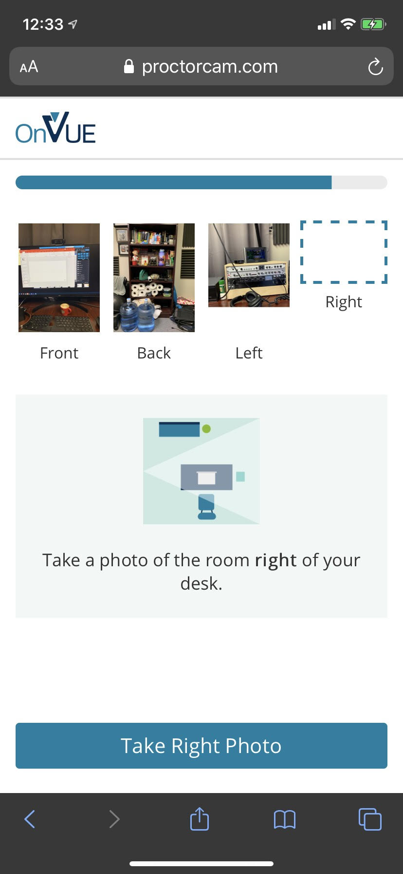
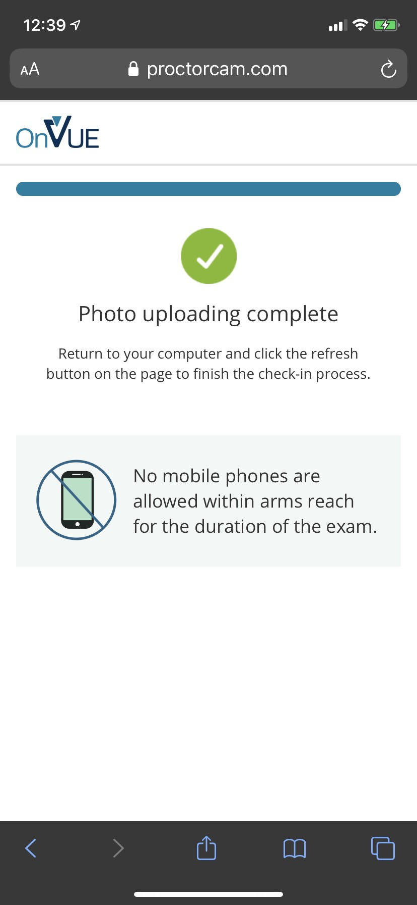

Slide 61
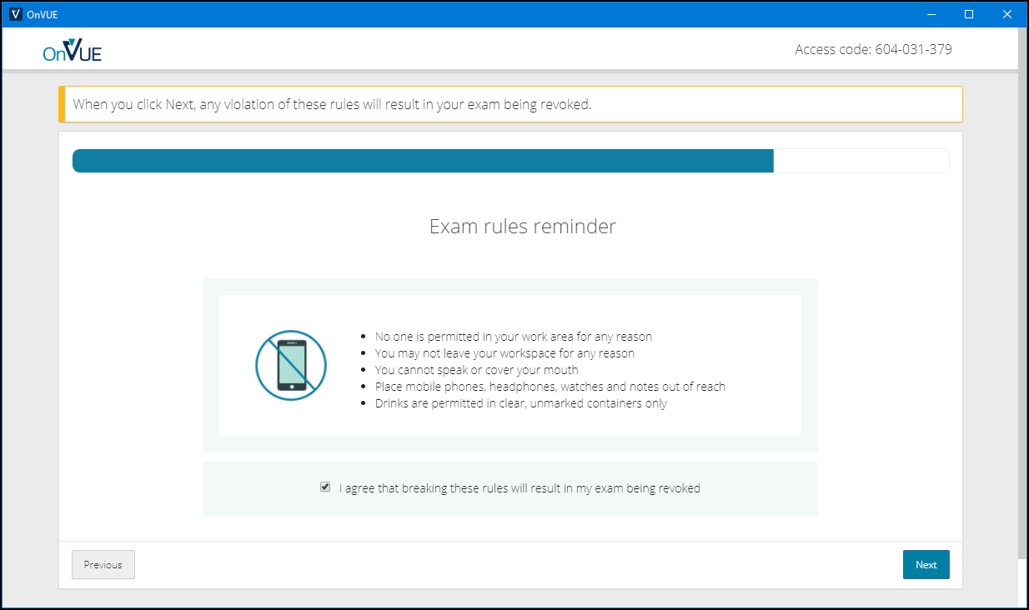

Slide 62
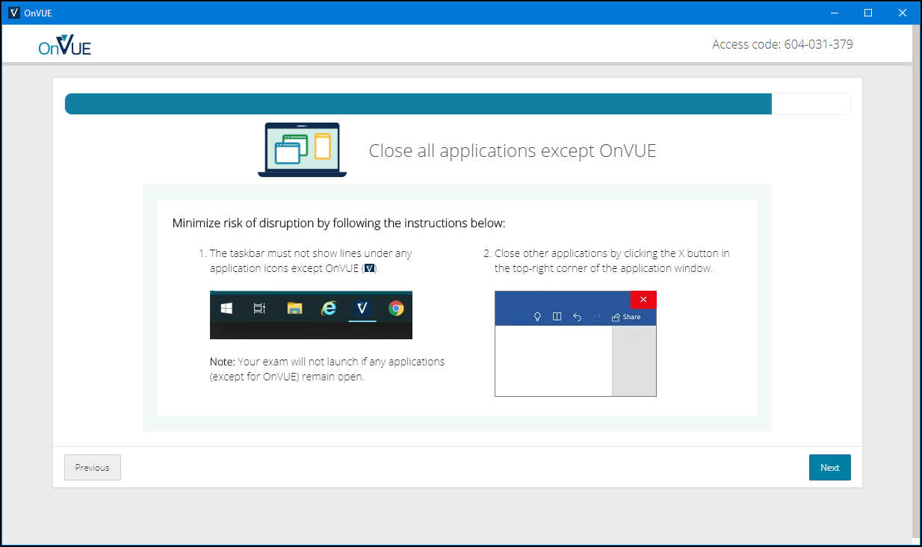

Slide 63
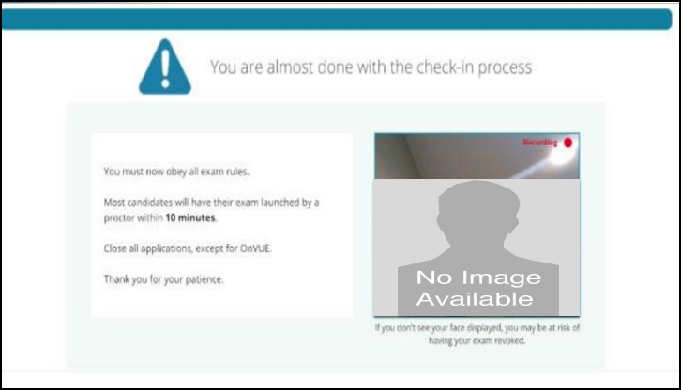

Slide 64
AZ-400 Exam Tips
Expect to see a lot of JSON, PowerShell, and Azure CLI
Expect NOT to see C# or JavaScript
It doesn't matter which exam order you use:
AZ-203
AZ-103/AZ-104
AZ-400
Perform due diligence in validating your environment for Microsoft online testing

Slide 65
AZ-400 Item Types

Slide 66

Single Answer Multiple Choice

Slide 67
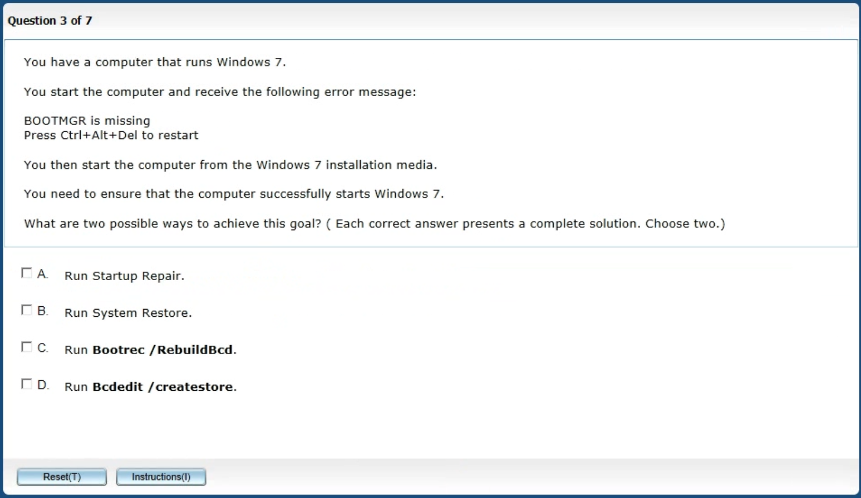
Multiple Answer Multiple Choice

Slide 68
Repeated Scenario
You need to move an Azure VM to another hardware host.
Solution: You redeploy the VM.
Does this solution meet the goal?
Yes
No

Slide 69
Repeated Scenario
You need to move an Azure VM to another hardware host.
Solution: You restart the VM.
Does this solution meet the goal?
Yes
No

Slide 70

Select and Place

Slide 71

Build List and Reorder

Slide 72

Active Screen/Fill in the Blank

Slide 73

Case Study

Slide 74






Performance-Based Lab

